Slide 1
Expense Reimbursement Flow
Ver1.0

Slide 2
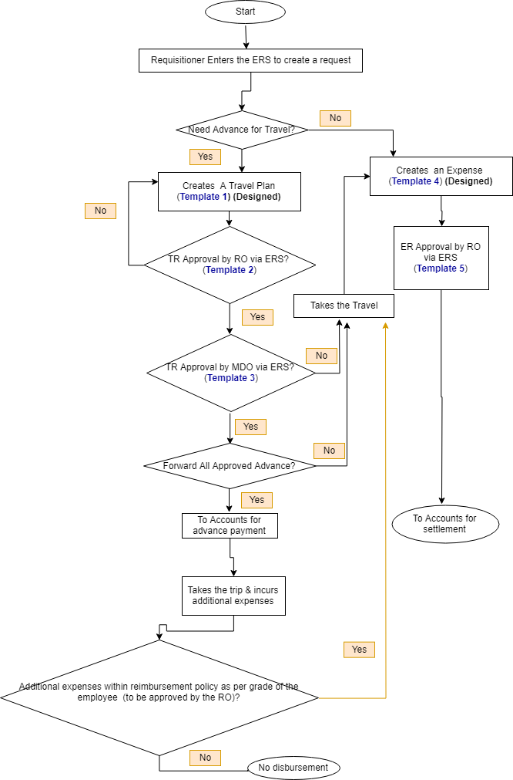
Purchase Procedure Ver3.0
TRACKER LEVELS
Level 1: Travel Plan Submitted.
Level 2: Expense Form Submitted.
Level 3a: TR Approved by RO.
Level 3b: ER Approved by RO
Level 4: TR approval by MDO
LEGEND TR: Travel Request RO: Reporting Officer ERS: Expense Reimbursement System MDO: Managing Director's Office
TM: Team Member

Slide 3
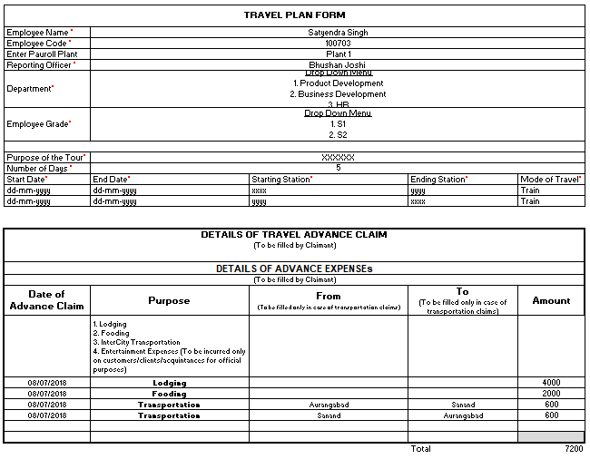
Form 1: PR Submission By Team Member
Template 1: TR Submission by TM
Submit
Cancel

Slide 4
Form 2: PR Approval By Lead
Template 2: TR Approval By Dept Lead
1 | PR No (Automatic) |  | PR-0052
2 | PR Date (Automatic, dd-mm-yyyy) |  | 22-02-18
3 | Requestor Name (Automatic) |  | Yogeshwar Kale
4 | Project Name/Purpose |  | RAGHAV S2S
5 | Item Name |  | Obstacle Sensor
6 | Make/ Manufacturer Name |  | PnF
7 | Item specifications
 | PBS03JN, 180 deg range
8 | Reference weblinks to the item:
 | www.pnf.com/pbs03jn www.amazon.com/pbs03jn
9 | Approx Unit Price |  | 50200 |  | Rs
10 | Qty Required |  | 1 |  | UOM | Nos
11 | Approx Total Price |  | 50200 |  | Rs
12 | Expected Delivery Date (dd-mm-yyyy) |  | 01-Mar-18
13 | Additional Comments or Instructions (Optional)
 | Long Range Sensor, UPS Expediated Shipping required
14 | Approve PR? Yes No
15 | Reason for Rejection: | Expense out of budget allotted
Attachment 1
Advance Booking Doc1.pdf
Attachment 2
Advance Booking Doc2.pdf
Attachment 3
Advance Booking Doc3.pdf
Approve
Reject

Slide 5
Form 2: PR Approval By Lead
Template 3: Travel Advance Approval By MDO
1 | PR No (Automatic) |  | PR-0052
2 | PR Date (Automatic, dd-mm-yyyy) |  | 22-02-18
3 | Requestor Name (Automatic) |  | Yogeshwar Kale
4 | Project Name/Purpose |  | RAGHAV S2S
5 | Item Name |  | Obstacle Sensor
6 | Make/ Manufacturer Name |  | PnF
7 | Item specifications
 | PBS03JN, 180 deg range
8 | Reference weblinks to the item:
 | www.pnf.com/pbs03jn www.amazon.com/pbs03jn
9 | Approx Unit Price |  | 50200 |  | Rs
10 | Qty Required |  | 1 |  | UOM | Nos
11 | Approx Total Price |  | 50200 |  | Rs
12 | Expected Delivery Date (dd-mm-yyyy) |  | 01-Mar-18
13 | Additional Comments or Instructions (Optional)
 | Long Range Sensor, UPS Expediated Shipping required
14 | Approve PR? Yes No
15 | Reason for Rejection: | Expense out of budget allotted
Attachment 1
Advance Booking Doc1.pdf
Attachment 2
Advance Booking Doc2.pdf
Attachment 3
Advance Booking Doc3.pdf
Enter Final Approved Amount
5000
Comments
Approve
Reject

Slide 6
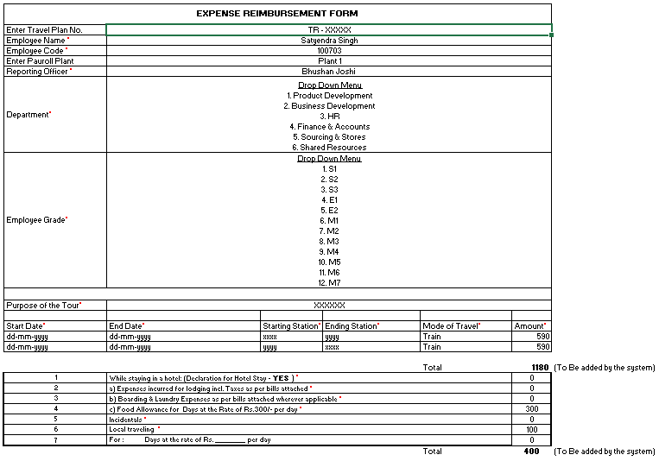
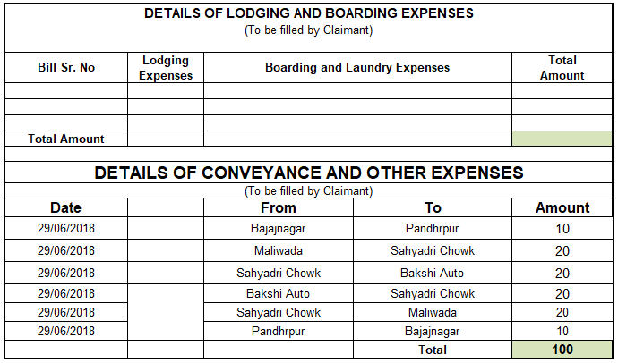

Form 1: PR Submission By Team Member
Template 4: ER Submission by TM
Approve
Reject

Slide 7
Form 1: PR Submission By Team Member
Template 5 : ER Approval by RO
Attachment 1
Incurred Expense Doc1.rar
Enter Final Approved Amount After Review as per company policy
1200
Comments (This should be mandatory field)
Submit
Cancel

